Slide 1

PIECEWISE-LINEAR RECURRENT NEURAL NETWORK - PLRNN
Presented By:
Jiaxin Su
June/08/2026

Slide 2
PLRNN
Simple RNN: a basic neural network for sequential data, such as time-series data. It updates a hidden state over time so that past information can influence future predictions.
PLRNN: a recurrent neural network formulated as a dynamical system. Like a simple RNN, it updates a hidden state over time, but it uses ReLU-based piecewise-linear rules, meaning the system follows different local linear rules in different regions of the latent space.

Slide 3
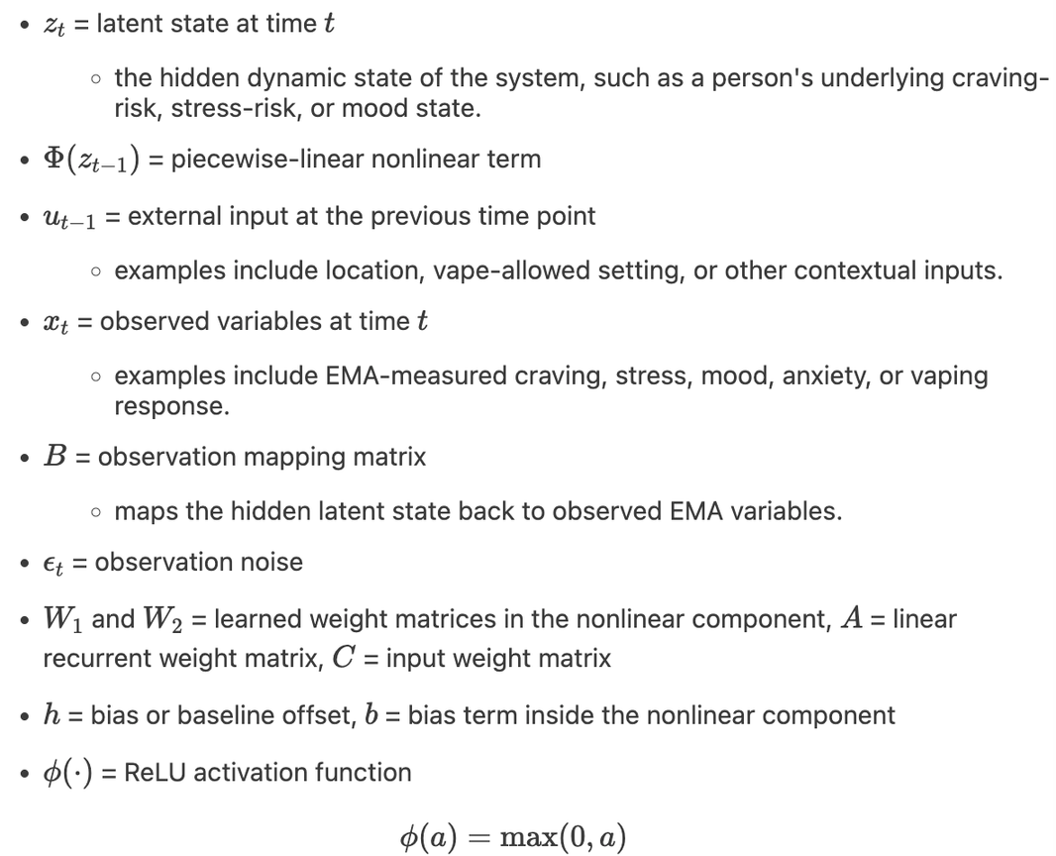


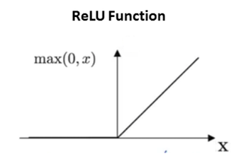
PLRNN
assumes that the observed or self-reported variables, such as stress (0-10), are generated from an underlying latent state space Zt​ that captures the person’s hidden psychological dynamics.
assumes this latent state evolves over time based on the previous latent state, external inputs, and piecewise-linear nonlinear rules
Notes:
relu --> less than 0, all equal to 0 and larger than 0, all follow the linear equation a

Slide 4
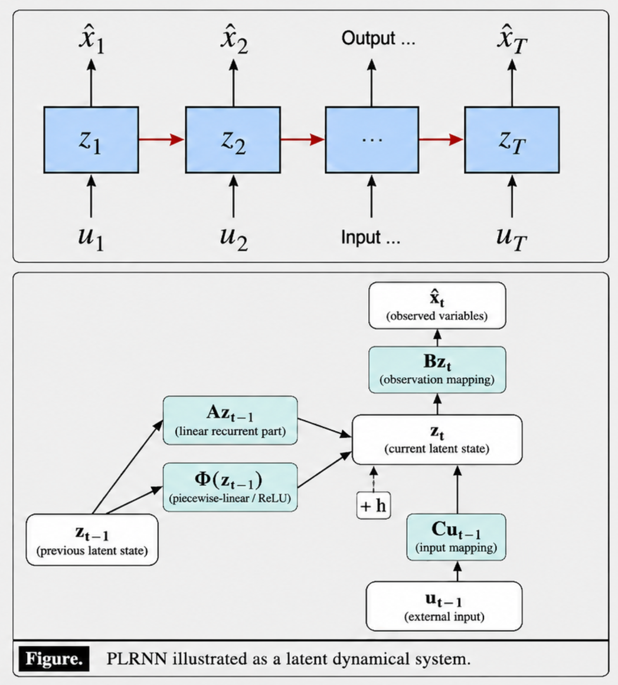
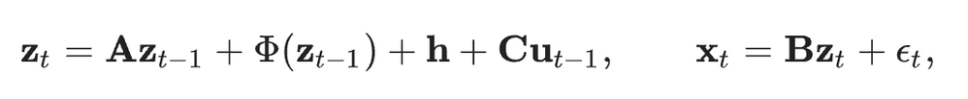

PLRNN

Slide 5
Why PLRNN
01
PLRNN is more structured
02
Interpretability Advantage
The pieces have clearer roles.
Azt−1 describes how the previous latent state carries forward, Cut−1 describes how external inputs shift the latent state, and Bzt describes how the latent state appears as observed variables.
ReLU creates local linear regions, so PLRNN can estimate “what affects what” over time.
Then B maps hidden-state changes back to observed or self-reported variables
Eg. stress t−1→craving t→ vaping t+1
Notes:
For example, higher stress at the previous survey could shift the person’s latent state, which may show up as higher craving at the next survey, and that elevated craving may then increase the risk of being about to vape at the following time point. it illustrates how PLRNN can translate hidden dynamics into interpretable temporal relationships among variables

Slide 6

Q&A

